Slide 3
Approval Code Request
Instruction Guide

Slide 4
Click Approval Code tab on the Homepage

Slide 5
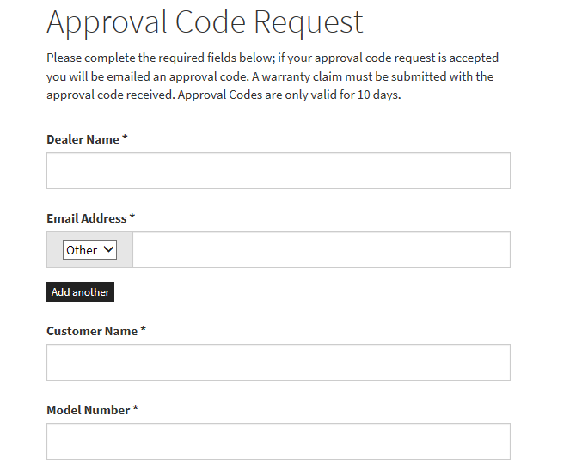
Dealer Account Name
Dealer Email Address
Customer’s First and Last Name
Model Number of Unit
Select an Option from the Drop Down List

Slide 6
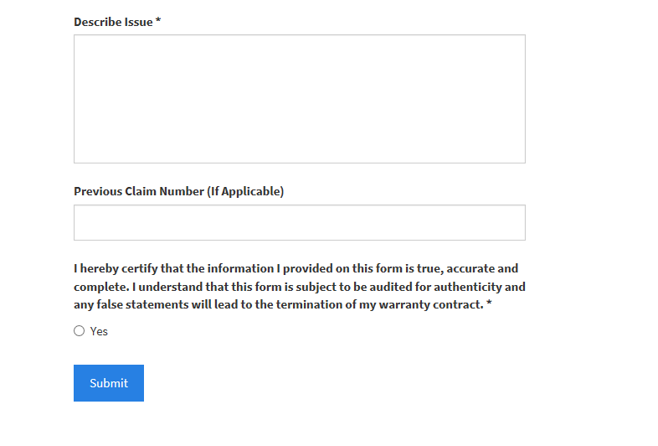
Please include very detailed notes to explain why the approval code is needed. If it is beyond repair, explain. If the part needed is not available, put the part needed here.
Previous Claim Number (If Applicable)
Click “Yes”

